Slide 1
Zagreb,
3rd February 2017
Hi4CSR Learning Activity
Stimulating the processing of used materials:
Current developments at EU level

Slide 2
Overview
Context
Legislative Framework
Other Policy Measures
General Observations
Recent Developments

Slide 3
1. Context
The European economy currently still loses a significant amount of potential 'secondary raw materials'
Waste of electrical and electronic equipment alone is one the fastest growing waste streams in the EU, with 9 million tons generated in 2005, and expected to grow to more than 12 million tons by 2020
In 2013, total waste production in the EU amounted to approximately 2.5 billion tons, of which 1.6 billion tons were not reused or recycled
It is estimated that an additional 600 million tons could be recycled or reused
Notes:
http://ec.europa.eu/environment/waste/index.htm
http://eur-lex.europa.eu/legal-content/EN/TXT/?uri=CELEX:52015PC0595
Waste of electrical and electronic equipment (WEEE) alone such as computers, TV-sets, fridges and cell phones is one the fastest growing waste streams in the EU, with some 9 million tonnes generated in 2005, and expected to grow to more than 12 million tonnes by 2020.
http://ec.europa.eu/environment/waste/weee/index_en.htm

Slide 4
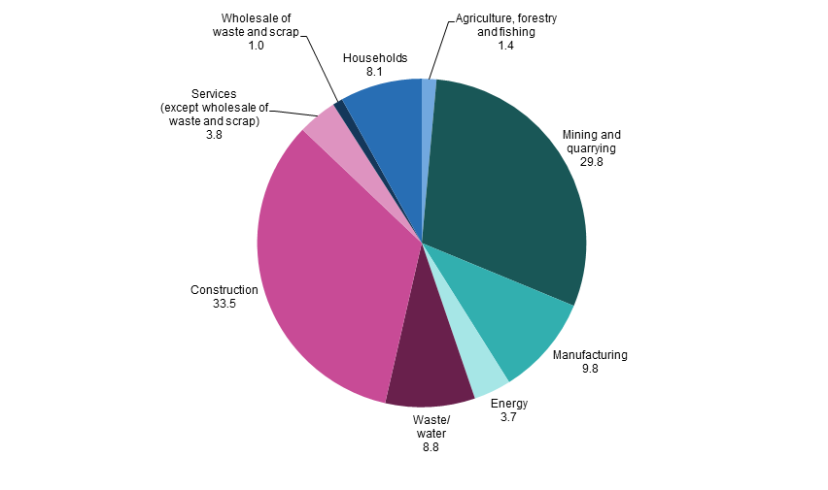
1. Context
Waste generation by economic activities and households, EU-28, 2014
Eurostat

Slide 5
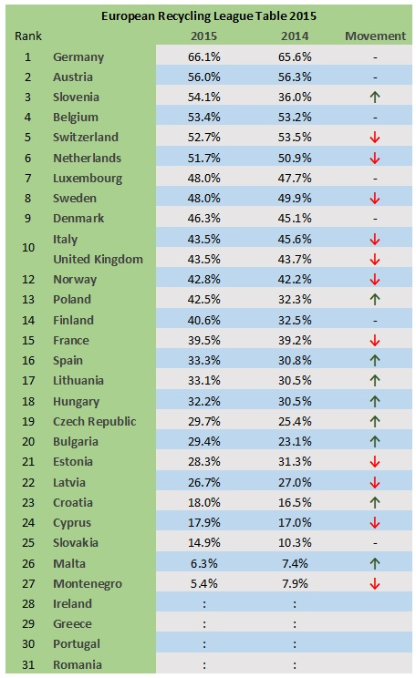
1. Context
Recycling of waste – EU Member States, 2015 - 2014
Eurostat
Notes:
http://www.letsrecycle.com/news/latest-news/uk-ranked-tenth-in-2015-european-recycling-table/

Slide 6
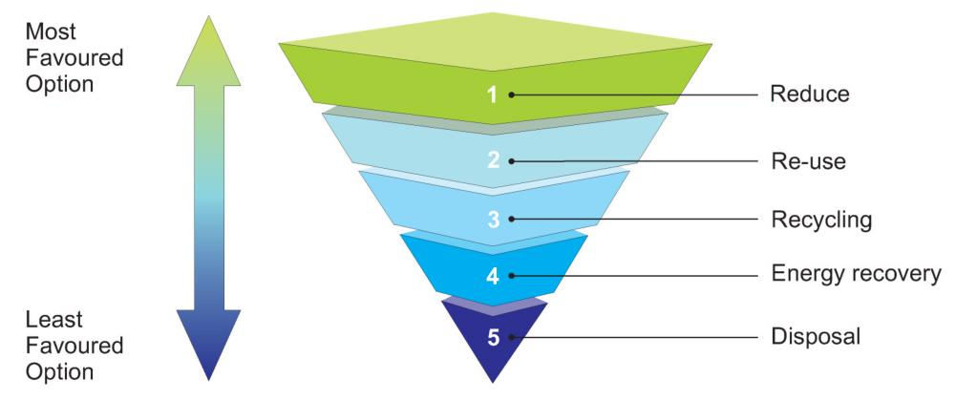
2. Legislative Framework
Waste Framework Directive (Directive 2008/98/EC)
introduced a five-step waste hierarchy where re-use is the second best option and recycling the third best
Notes:
The EU approach to waste management is based on the "waste hierarchy“, which sets the following priority order when shaping waste policy and managing waste at the operational level: prevention, (preparing for) reuse, recycling, recovery and, as the least preferred option, disposal (which includes landfilling and incineration without energy recovery). In line with this the 7th Environment Action Programme sets the following priority objectives for waste policy in the EU:
To reduce the amount of waste generated;
To maximise recycling and re-use;
To limit incineration to non-recyclable materials;
To phase out landfilling to non-recyclable and non-recoverable waste;
To ensure full implementation of the waste policy targets in all Member States.

Slide 7
2. Legislative Framework
VAT Directive (Directive 2006/112/EC)
Article 199 setting out that
“1. Member States may provide that the person liable for payment of VAT is the taxable person to whom any of the following supplies are made:
…
(d) the supply of used material, used material which cannot be re-used in the same state, scrap, industrial and non industrial waste, recyclable waste, part processed waste and certain goods and services, as listed in Annex VI”

Slide 8
3. Other Policy Measures
Raw Materials Initiative (COM/2008/0699)
development of best practices in collection and treatment of waste
Improvement of availability of statistics on waste and materials flows
further review of EU waste and Eco-design legislation
support research and innovation
promotion of economic incentives for reuse and recycling
improvement of the enforcement of EU rules on how waste may be traded
in particular to tackle illegal shipments of waste to non-OECD countries
Roadmap to a Resource Efficient Europe (COM(2011) 571)
to transform Europe's economy into a sustainable one by 2050 by
increasing resource productivity and
decoupling economic growth from resource use and its environmental impact
Notes:
Policy and strategy for raw materials → Resource efficiency and recycling
https://ec.europa.eu/growth/sectors/raw-materials/policy-strategy/resource-efficiency_en

Slide 9
3. Other Policy Measures
7th Environment Action Programme (2013)
In line with the waste hierarchy, sets the following priority objectives for EU waste policy:
reduce the amount of waste generated
maximise recycling and re-use
limit incineration to non-recyclable materials
phase out landfilling to non-recyclable and non-recoverable waste
ensure full implementation of the waste policy targets in all EU Member States
Notes:
Policy and strategy for raw materials → Resource efficiency and recycling
https://ec.europa.eu/growth/sectors/raw-materials/policy-strategy/resource-efficiency_en

Slide 10
4. General Observations
Apparent lack of clear policy in terms of secondary raw materials (ARCADIS & Triconomics, 2016)
no roadmap to increase reincorporation of recycled materials in manufacturing processes
lack of incentives like price guarantees, insurance systems, harmonised Green Public Procurement criteria or guidelines
the use of recycled material is not supported by policy measures at a same level as waste recycling
some current waste legislations hinders the development of secondary raw materials markets as some ‘waste’ cannot be used further as a material
Notes:
(ARCADIS & Triconomics Study on the efficient functioning of waste markets in the EU, 2016)

Slide 11
4. General Observations
EU waste policies led to a priority for recycling, at the expense of re-use, which is much more energy and resource efficient as well as labour intensive (RREUSE, 2015)
Suggestions to policy makers (ibid.), among the others
concrete legislative support beyond legal definitions
separate quantitative targets for re-use away from recycling
safeguarding and developing the role of social enterprises in the re-use sector
adapting Extended Producer Responsibility to support preparation for reuse activities
re-use, repair and preparing for re-use more economically viable and competitive
Innovative use of differentiated VAT rates in accordance with the waste hierarchy These taxes should be shifted to put a higher burden on resource-intensive and single use products
Notes:
e.g. zero VAT on repair services and sale of second hand products.

Slide 12
5. Recent Developments
Circular Economy Package (2015)
which includes revised legislative proposals on waste, setting clear targets, implementation plan and concrete measures at MS level for reduction of waste
common EU target for recycling 65% of municipal waste by 2030
common EU target for recycling 75% of packaging waste by 2030
binding landfill target to reduce landfill to maximum of 10% of municipal waste by 2030
ban on landfilling of separately collected waste
promotion of economic instruments to discourage landfilling
improved definitions and harmonised calculation methods for recycling rates
concrete measures to promote re-use and stimulate industrial symbiosis - turning one industry's by-product into another industry's raw material
economic incentives for producers to put greener products on the market
Notes:
http://ec.europa.eu/environment/waste/target_review.htm

Slide 13
5. Recent Developments
Circular Economy: Turning recycled raw materials into business opportunities
Overcoming barriers by developing quality standards for secondary raw materials, harmonising the rules on by-products and end-of-waste status and facilitating the legal transportation of waste
Secondary raw materials as a key investment area in particular waste collection infrastructure, reverse logistics, sorting or recycling and new technologies + redirection of private finance to this area
Work in specific areas
Returning the earth's resources
Re-using construction waste
Recovering critical raw materials
Plastic as a recyclable resource
Care with chemicals
The role of SMEs
Notes:
http://ec.europa.eu/environment/waste/target_review.htm

Slide 14
5. Recent Developments
The Action Plan of the Circular Economy Package with a renewed focus on resource efficiency, re-use strategies and secondary raw materials is very much timely and welcome
Circular Economy Stakeholder Conference: one year after adoption, working together for the future, Brussels, 9-10th March 2017
Product policy for resource efficiency: how to make progress?

Slide 15
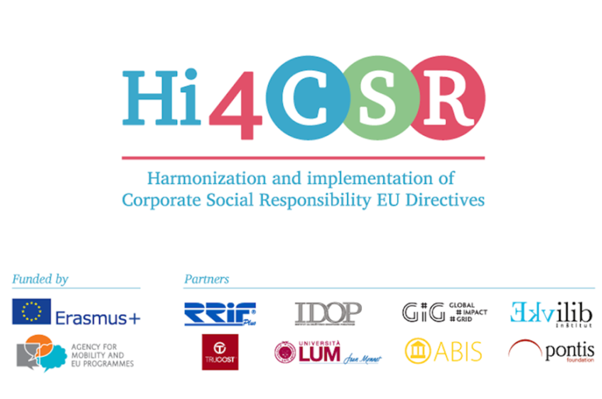
Thank you for your attention!
Karolina Sobczak
Projects Coordinator

