Slide 1
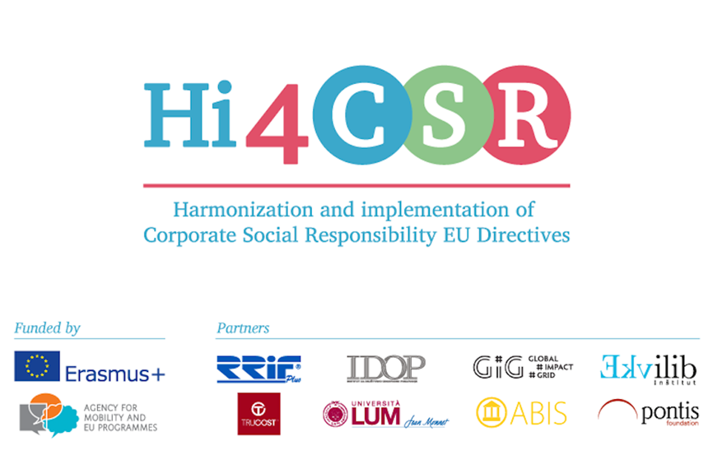
Ekvilib Institute

Slide 2
NGO
Founded in 2003
Currently 5 employees + 1 on maternity leave

Slide 3
Main products, services and activities

